Slide 1
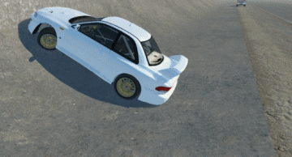

AUTOMOTIVE BIW - LATERAL CRASH STRENGTH AND PERFORMANCE IMPROVEMENT OF B-PILLAR DESIGN WITH FEA
Project ID #14
Omotoso Ayotunde
Student ID: 110041613
Yashwanth Ramesh
Student ID: 110060950
Adithya Rishikesh
Student ID: 110047114
Submitted to
Dr. Sudip Bhattacharjee, Ph.D., P.Eng
Adjunct Prof., Faculty of Engineering, University of Windsor

Slide 2
AGENDA
Aim/ goal of the Project
Introduction
Methodology:
Initial Analysis of the original B-pillar Model
Final optimization design of the B-pillar
Conclusion

Slide 3
PROJECT GOAL
In this project, we will mainly be using Hyper Mesh for model pre-processing and ABAQUS as a FEA solver to determine the lateral crash strength of B-pillar. Our goal is to reduce the displacement and stress imparted on B pillar for the imposed load while maintaining the material's yield strength. The optimised B-pillar should withstand a force of 140kN with a lower displacement rate than the original B-Pillar. As a result, this should show our final design has an improved stiffness and impact resistance against collision forces acting laterally or sideways on vehicles during road accidents.

Slide 4
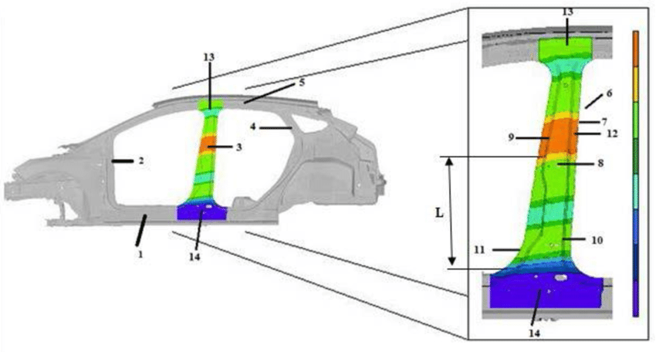
INTRODUCTION
What is a B-pillar?
The vertical support that separates a car's front and rear or central side windows. The B-pillar is also known as a “post” which serves as a member that adds support to a car’s roof panel and it’s also mounted sideward at the mid-section of a car for latching the front door and set up of the inches for the rare door. It is a vertically closed steel structure that is welded to the vehicle's rocker panel and floor pan at the bottom and to the roof panel at the top for installation purposes. The B-pillar is made up of various structural components which varies depending on the manufacturer and it is important to note that a vehicle structure still includes other components that form part of the protection structure, such as the C-pillar, A-pillar, rocker panel, floor pan, roof panel, and so on.
Features of a B-pillar

Slide 5
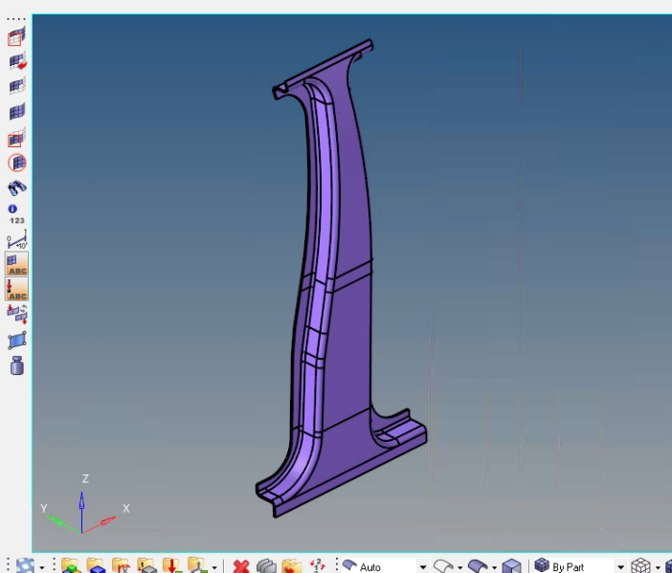
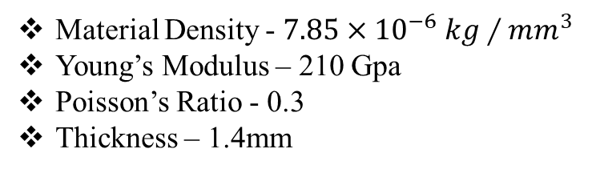
Initial Design of B-pillar used for Analysis
Material Density - $7.85×{10}^{−6} kg∕{mm}^{3}$
Young’s Modulus – 210 Gpa
Poisson’s Ratio - 0.3
Thickness – 1.4mm
3D view of B-piller

Slide 6
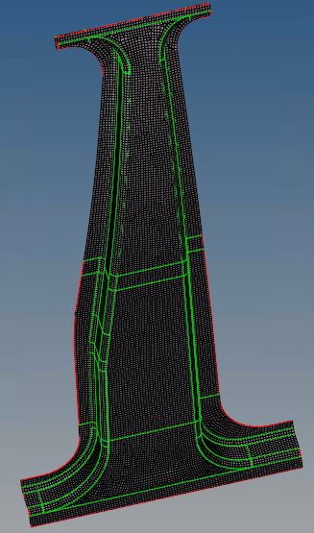
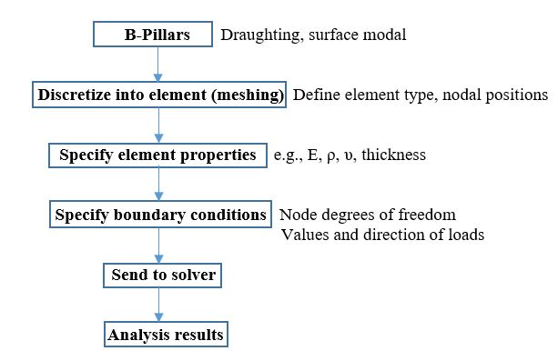
Flow Chart Representing the Procedure followed in FEA
Meshed B-pillar

Slide 7
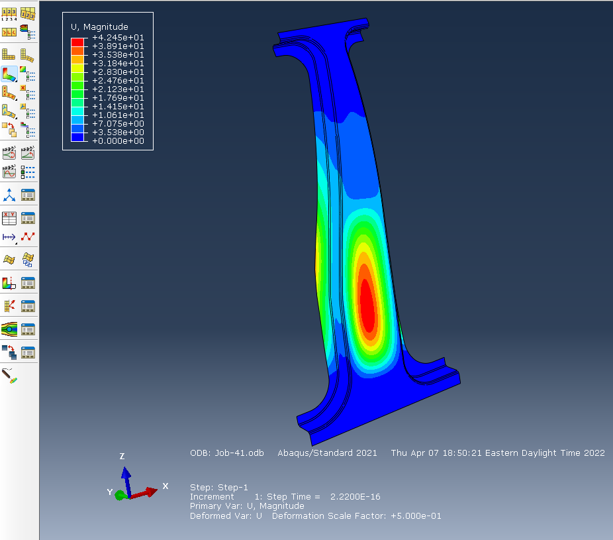
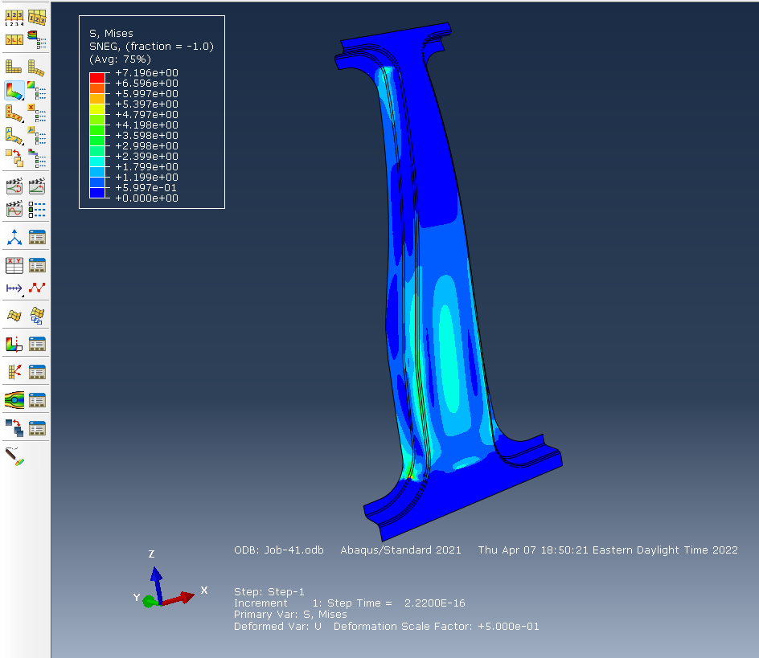
Analysis Results of lateral Crash strength of B-Pillar
Result showing displacement due to Force acting on B-pillar
Results showing Von Mises stress of B-pillar

Slide 8
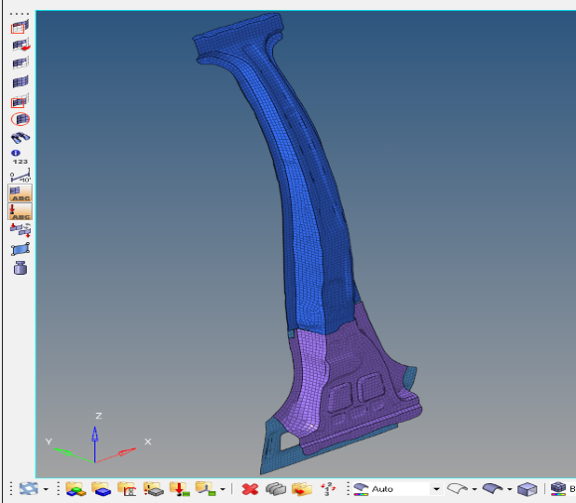
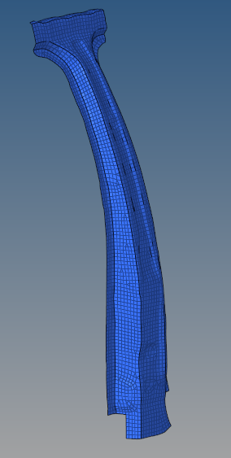
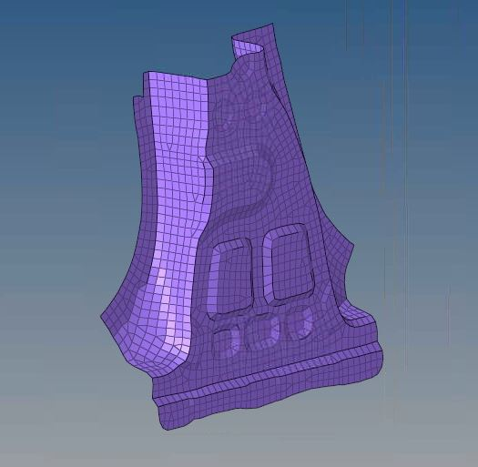
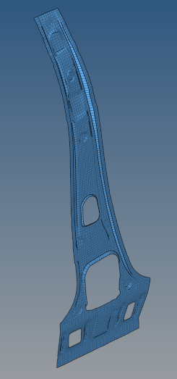
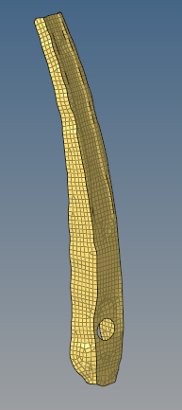
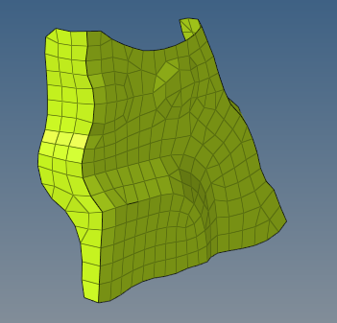
Design of Performance Improved B-pillar and it’s Reinforcements
Centre flange
Lower Segment
Inner Support
Internal Support
Bracket
3D view of Reinforced B-pillar

Slide 9
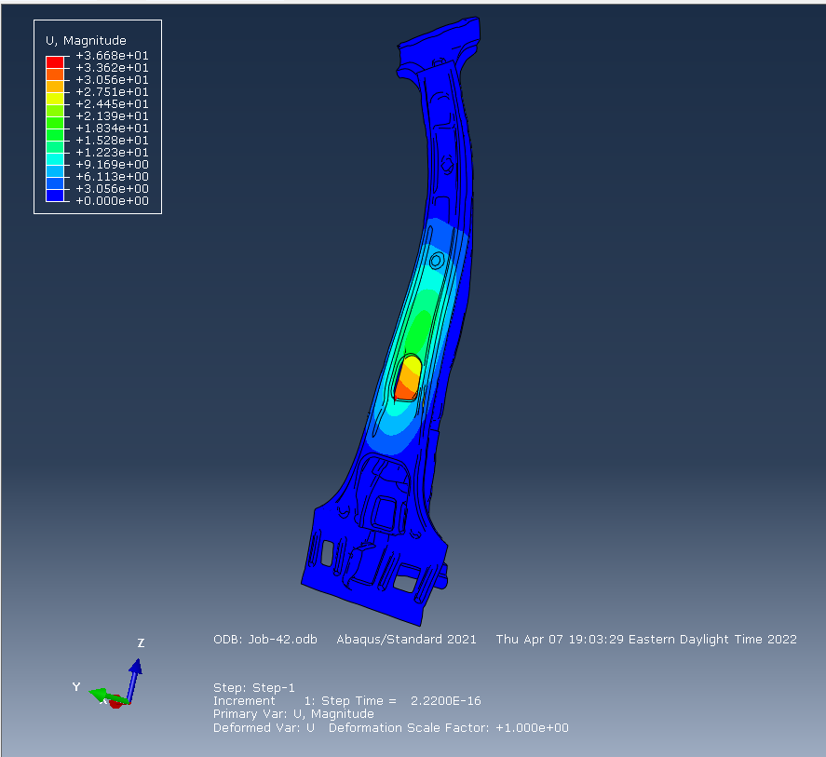
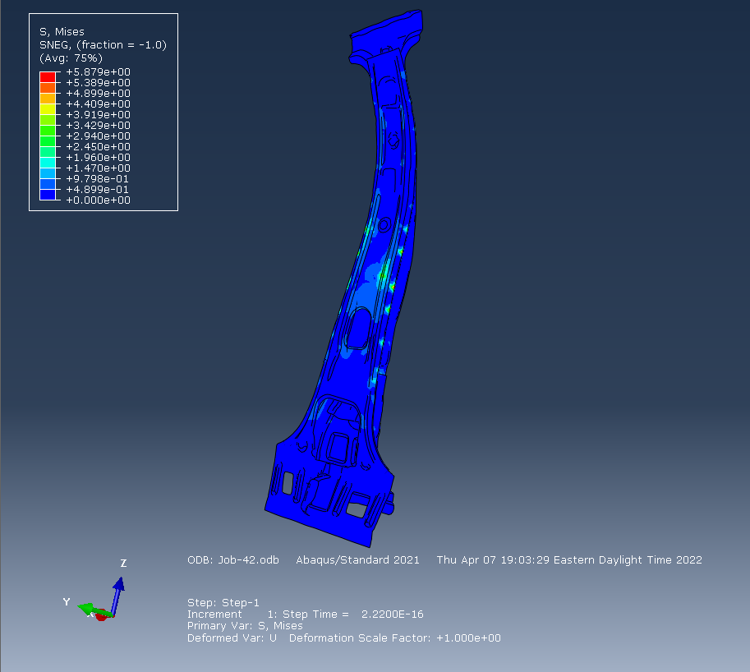
Analysis Results of lateral Crash strength of Reinforced B-Pillar
Result showing displacement due to Force acting on reinforced B-pillar
Results showing Von Mises stress of Reinforced B-pillar

Slide 10
Conclusion
Our primary objective was to improve the performance of B-pillar for side impact. Hence The B pillar was initially subjected to a uniform loading of 140KN, with the analysis revealing Von Mises stress and displacement values. In order to improve the performance of the B-pillar Von Mises stress and displacement in the B-pillar had to be minimised, as per our goal. Hence To withstand the lateral impact, a B-pillar was added with reinforcements to change and the design was changed a bit. The material properties of the reinforced B-pillar was same as the initial B-pillar. As a result, the Von Mises stress of Reinforced B pillar reduced from 7.196 Gpa to 5.879 Gpa and Displacement reduced from 42.45mm to 36.68mm.

Slide 11
THANK YOU

